Slide 1

Matrimonial Portal
Prepared By: Anish Budhathoki

Slide 2
Introduction
Matrimonial Website is an online service which is use to place wedding service providers on one platform. It is a kind of Business-to-Consumer portal to provide clientage to the business for more business and more profit. It helps to find the right partner for the users and match making according to their choices.

Slide 3
Obejectives
To store the data of user securely.
To analyzing the activities of the consumer.
To maintaining and upgrading the quality of site.
To find the weakness and capabilities of the site.

Slide 4
Aims
To provide a user-friendly environment.
To provide best way for matchmaking.
To show detailed information of the person regarding his/her information.
To fulfill need of the individuals which cannot find their life partners.
To make simple and responsive design.

Slide 5
Features
Login and Registration of the user:
CRUD Operations for adding, updating, deleting and retrieving the operation:
Messaging to the matched preferences:
Viewing others profile:
Admin Control:
Searching user profile:
Rating other users:

Slide 6
Development Methodology
Methodology that is chosen for this project is Waterfall model. It is a classic approach to the systems development method that is linear and sequential. The right selection of methodology leads to the successful project.
Waterfall model is used because it is a sequential design process in which progress is seen as flowing steadily downwards (like a waterfall) through phases. In a Waterfall model, each phase must complete to begin the other one and there is no overlapping

Slide 7
Design Pattern
Design pattern describes a general solution to a design problem that recurs repeatedly in many projects. It uses a formal approach to describing a design problem its proposed solution, and any factors that might affect the problem or the solution.
Design pattern used in this project is MVC design pattern. Model-View-Controller(MVC) helps to separate an application into three main logical components the model, the view and the controller.

Slide 8
Use-Case Diagram
A use case is a methodology used in system analysis to identify, clarify, and organize system requirements. The use case is made up of a set of possible sequences of interactions between systems and users in a particular environment and related to a particular goal. It consists of a group of elements (for example, classes and interfaces) that can be used together in a way that will have an effect larger than the sum of the separate elements combined. The use case should contain all system activities that have significance to the users. A use case can be thought of as a collection of possible scenarios related to a particular goal, indeed, the use case and goal are sometimes considered to be synonymous.

Slide 9
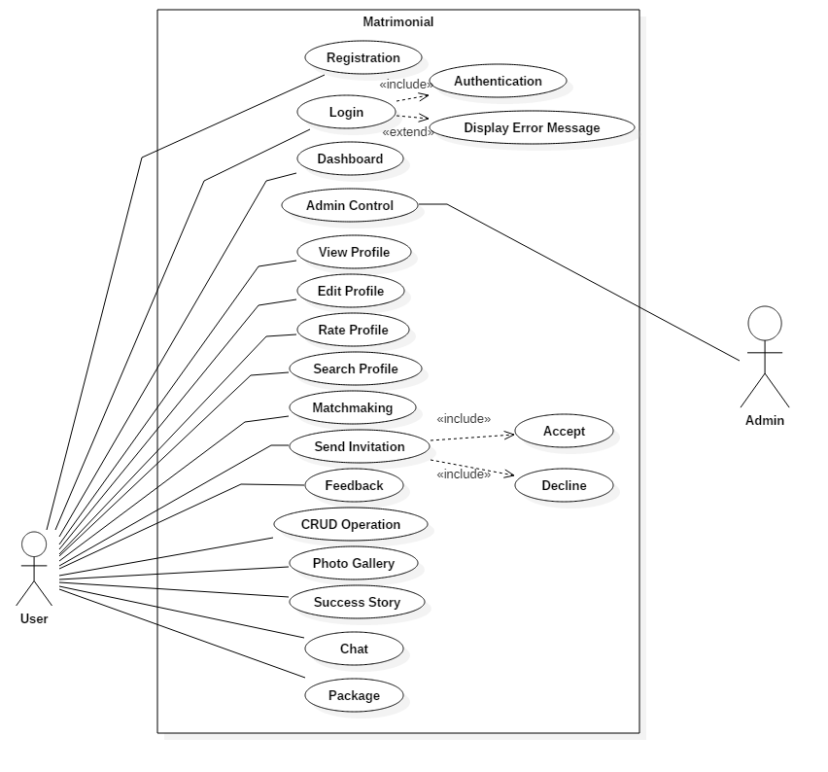
Use-Case

Slide 10
ER-Diagram
Entity Relationship Diagram, also known as ERD, ER Diagram or ER model, is a type of structural diagram for use in database design. An ERD contains different symbols and connectors that visualize two important information: The major entities within the system scope, and the inter-relationships among these entities

Slide 11
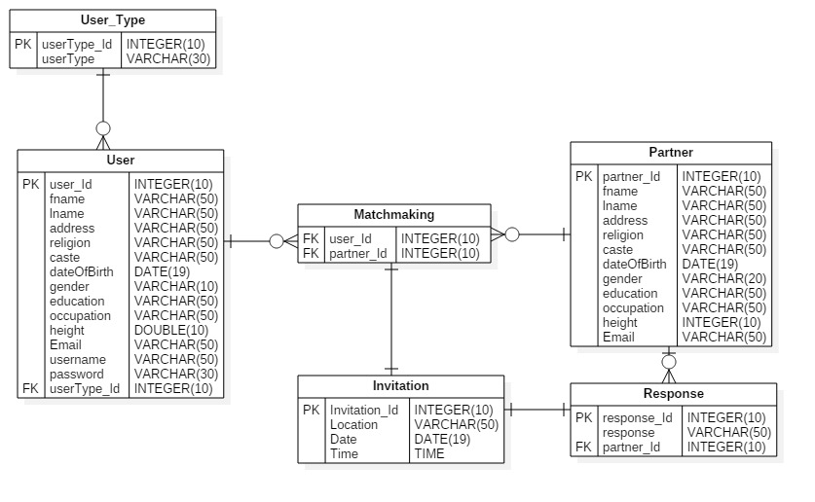
ER-Diagram

Slide 12
Class-Diagram
Class diagram is a static diagram. It represents the static view of an application. Class diagram is not only used for visualizing, describing, and documenting different aspects of a system but also for constructing executable code of the software application.
Class diagram describes the attributes and operations of a class and also the constraints imposed on the system. The class diagrams are widely used in the modeling of object oriented systems because they are the only UML diagrams, which can be mapped directly with object-oriented languages.
Class diagram shows a collection of classes, interfaces, associations, collaborations, and constraints. It is also known as a structural diagram.

Slide 13
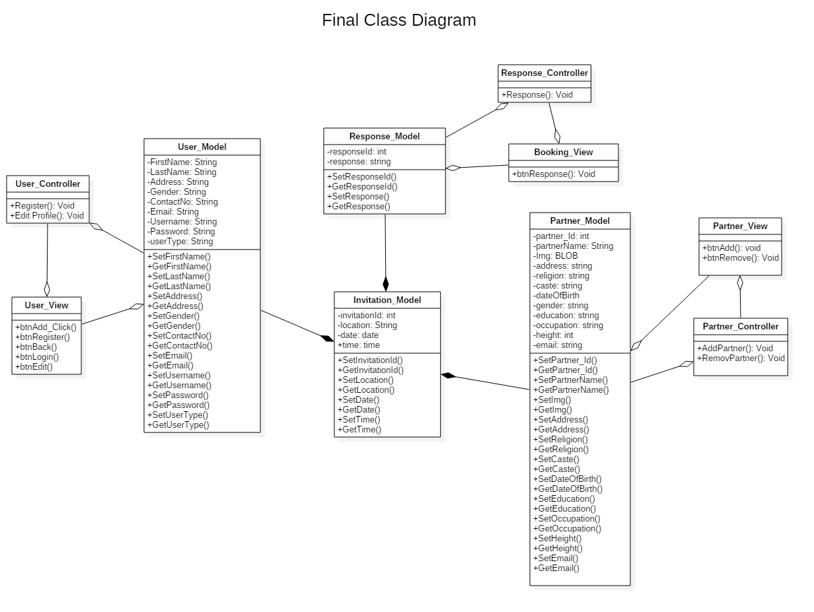
Class-Diagram

